Slide 1

March 2026
CRICKET
SIMULATOR
Adi Jain(24114003)
Ainesh Kumar Das(24114008)
Atishay Jain(24114018)
Dakshit Tanay(24114030)
Lakshit Jain(24114055)
IIT Roorkee

Slide 2
CONTENTS
01. System Architecture
06. Critical Section
02. Assumptions
07. Run-Out Handling
03. Thread Design
08. Output Demo
04. Synchronization
09. Gantt Chart
05. Scheduling
10. Conclusion

Slide 3
SYSTEM ARCHITECTURE
Libraries Used
Library | Header | Purpose
POSIX Threads | <pthread.h> | Creation of Batsman, Bowler, Fielder, Umpire threads
GCD Semaphores | <dispatch/dispatch . h> | Crease capacity control
UNIX Standard | <unistd.h> | usleep() for thread timing
File I/O | <fstream> | Exporting match report to . txt
C Standard | <stdio.h>, <stdlib.h>, <string.h> | I/O, Memory, String Ops
Time (C++) | <chrono> | Gantt chart microsecond timestamps

Slide 4
SYSTEM ARCHITECTURE
header.hpp → All structs, enums, extern declarations
globals.cpp → Single source of truth for all shared variables (score, wickets, state, semaphores)
main.cpp → Entry point, toss logic, innings starting, thread creation & joining
umpire.cpp → Umpire thread + next_bowler() scheduler, drives the state mutex, logs every ball
batsman.cpp → Striker & Non-striker thread logic, crease semaphore acquisition & release
bowler.cpp → Bowler thread, delivers ball
fielder.cpp → Fielder thread, wakes on SHOT signal, Handles catches, run-outs, boundaries
utility.cpp → my_rand_r(), update_balls(), over transitions, bowler rotation, probability engine bowlerprob() / batprob() / fldprob()
gantt.cpp → gantt_log() — timestamped resource logger
print.cpp → CricketTable renderer, scorecard printer, match report exporter to .txt file

Slide 5
ASSUMPTIONS
6 Bowlers will be used at max
No Super Over/DLS Method - Innings ends at 10 wickets or 20 over or target chased
Considering death over to be 20th over only
No fielding positions modeled
Middle order batsman is 6th batsman only
All probabilities are hand-tuned - Based on real T20 averages, not player-specific stats
Pressure increases aggression - compute_pressure() uses required run rate
Gantt chart is microsecond-based - std::chrono::high_resolution_clock in gantt.cpp
The bowler will never throw no ball
There is a possibility of runout on every run taken
Next batsman is decided randomly

Slide 6
THREAD DESIGN
There are 4 thread types:
Bowler Thread: 1 active thread.
Wakes on state=1.
Sleeps on Bowler condition variable locked on state mutex.
Batsmen Thread: 11 threads (one per player).
Wakes on state=2.
Sleeps on Batsman condition variable locked on state mutex.
Fielder Thread: 10 thread (one per fielder).
Wakes on state=3.
Sleeps on Fielder condition variable locked on state mutex.
Umpire Thread: 1 thread.
Wakes on state=0.
Sleeps on Umpire condition variable locked on state mutex.

Slide 7
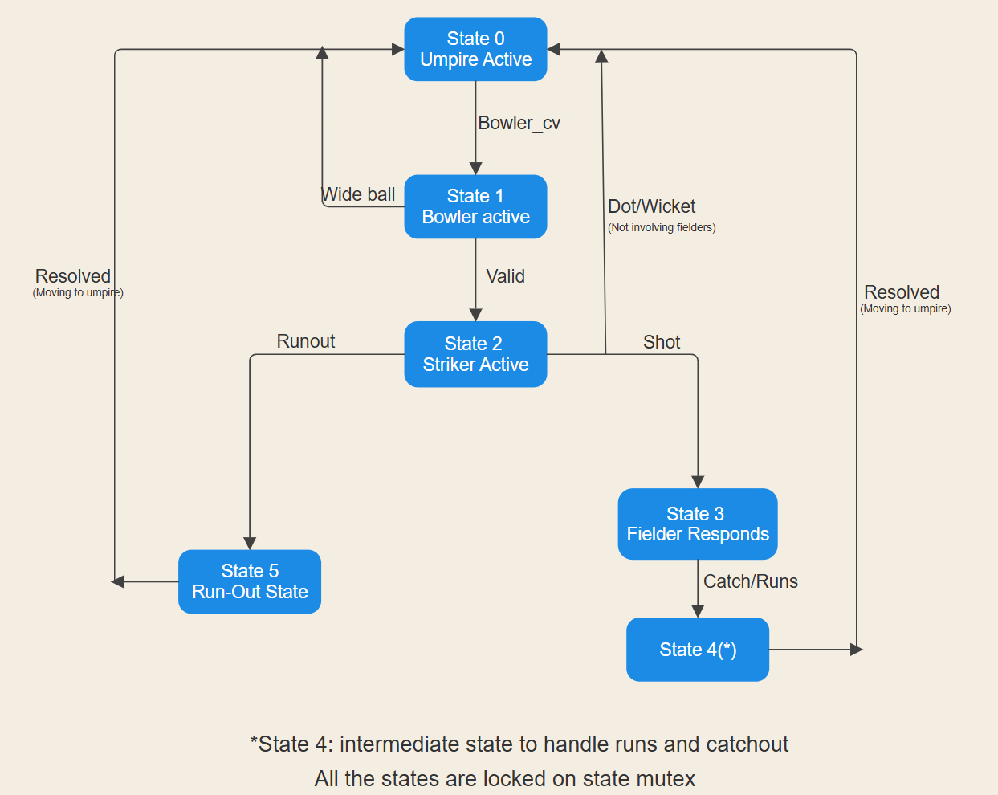

Slide 8
SYNCHRONIZATION
Mutex locks:
state_mx - master lock, held whenever any thread reads or modifies state or shared game data
rag_mutex - protects the RAG vector from concurrent edge insertions/deletions
gantt_mx - Serializes Gantt log writes so entries are never interleaved
Condition Variables (CV’s):
Four dedicated CVs: umpire_cv, bowler_cv, batsman_cv, fielder_cv
Each thread sleeps on its own CV — no unnecessary wakeups to unrelated threads
Umpire uses pthread_cond_signal (one target); batsman uses pthread_cond_broadcast (both striker + non-striker wake together)
Crease Semaphore system:
crease_sm(2)- limits 2 batsmen on the pitch at any time. All 11 threads try to acquire it, only 2 succeed.
crease0_sm(1)- the striker crease. First batsman who grabs it becomes the striker.
crease1_sm(1)-the non-striker crease. Other batsman becomes the non-striker.
On dismissal: the dismissed batsman signals their crease semaphore back, allowing the next queued batsman to take it.

Slide 9
SCHEDULING
The Umpire thread acts as the master scheduler for each ball.
The Central Scheduler: The Umpire thread acts as the CPU scheduler, controlling the execution flow and state transitions for Bowlers, Batsmen, and Fielders.
Round-Robin (Normal Overs): Employs a sequential rotation algorithm for bowlers, strictly enforcing a 4-over maximum resource quota.
Priority Preemption (Death Over): At the 20th over, normal rotation is preempted. The Umpire dynamically assigns the over to the available bowler with the highest priority/specialist rating.
Cooperative Thread Suspension: Instead of wasting CPU cycles (busy-waiting), the scheduler uses condition variables (e.g., pthread_cond_broadcast) to put non-active threads to sleep until it is their turn to execute.

Slide 10
CRITICAL SECTION
Mutex locks enforce critical sections to prevent race conditions when multiple threads modify the shared match state simultaneously.
Game State Protection (state_mx): A primary mutex secures the global match variables (score, wickets, current state) against simultaneous access by different player threads.
Deadlock Graph Security (rag_mutex): Protects the Resource Allocation Graph (RAG) during run-out simulations, utilizing a clever "snapshot" technique to prevent recursive deadlocks.
Thread-Safe Logging (gantt_mx): Ensures safe concurrent writes to the shared event log array, maintaining an accurate chronological sequence of events.

Slide 11
RUN-OUT HANDLING
Run-out is triggered on every SINGLE, DOUBLE, or TRIPLE (do_runout = true). It is used to demonstrate a deadlock scenario using a Resource Allocation Graph (RAG).
Trigger Fielder: sets runout_initiated = true, resets all flags (runout_flag, striker_running_done, non_striker_running_done), sets state = 5 and broadcasts batsman_cv to wake both batsmen simultaneously.
Deadlock Simulation: Both batsmen run do_running_deadlock_sim() concurrently — striker requests sem_A then sem_B, non-striker requests sem_B then sem_A. This creates a circular wait. Meanwhile the fielder spin-waits outside state_mx, polling both _done flags with usleep(10) between checks.
Deadlock Detection: The fielder calls is_deadlocked() inside its spin-wait loop. This function takes a snapshot of the RAG under rag_mutex, releases the lock, then runs DFS cycle detection on the snapshot. On detecting a cycle it sets runout_flag = true, forcibly releases the resources of any batsman and signals both semaphores back.

Slide 12
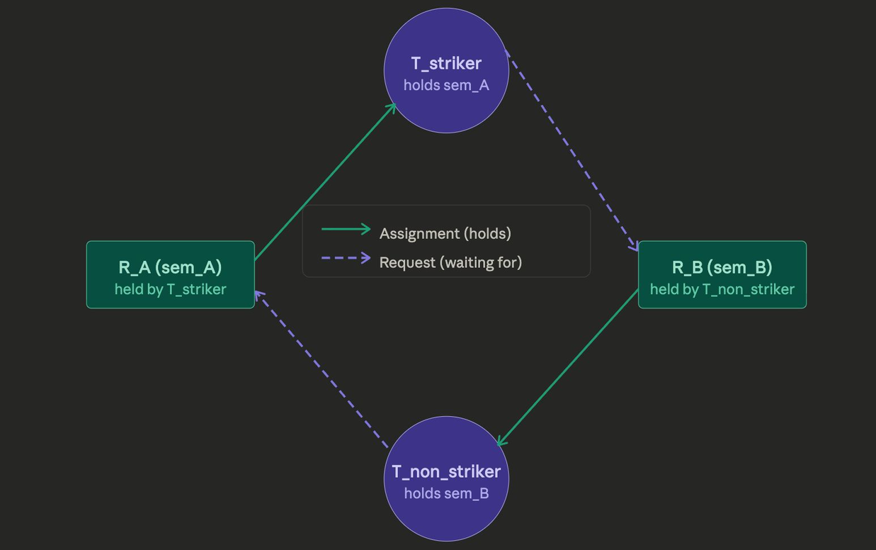
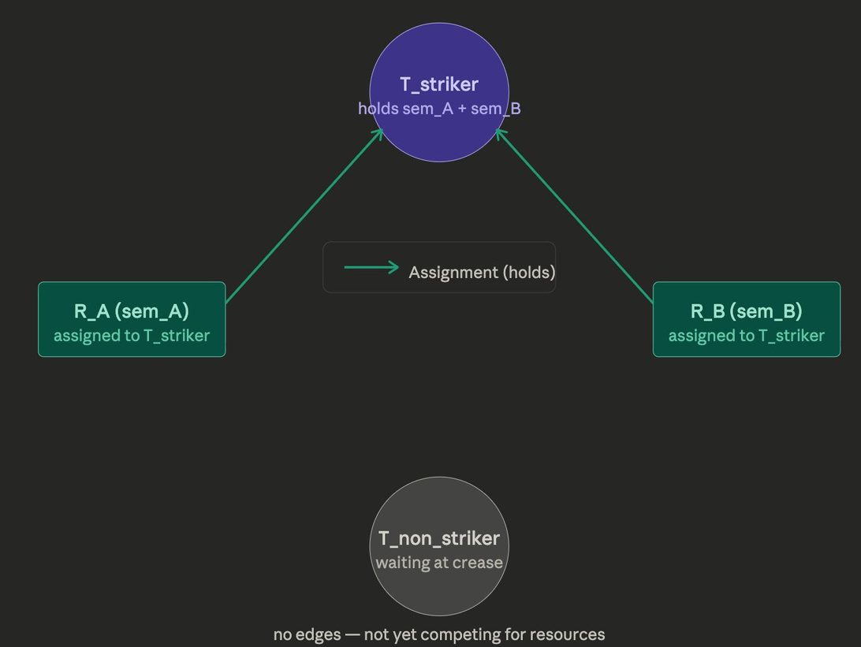
Deadlock
No Deadlock

Slide 13
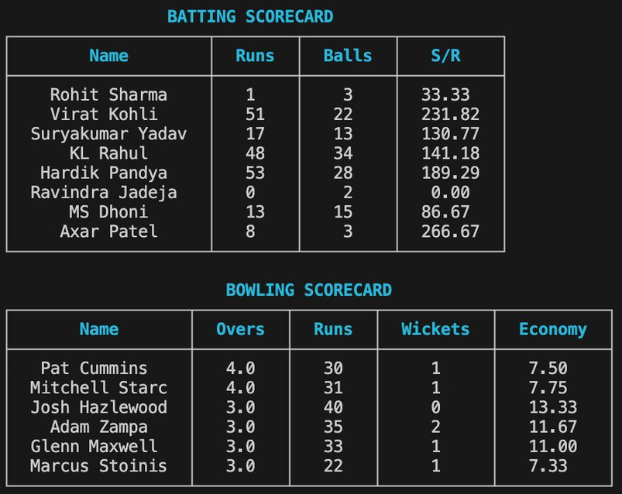
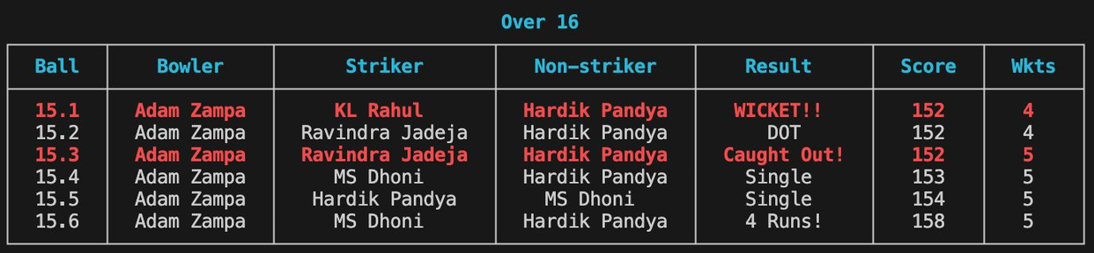
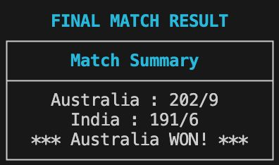
OUTPUT DEMO
The simulator produces three outputs:
Console output — printed live during the match with ANSI color support:
Batting scorecard (name, runs, balls, strike rate)
Bowling scorecard (name, overs, runs, wickets, economy)
Ball-by-ball log grouped by over, showing bowler, striker, non-striker, result and score for every delivery
Gantt chart table
Final match result
Match report file — same content exported to a timestamped .txt file (match_report_YYYY-MM-DD_HH-MM.txt) in append mode so both innings are written to the same file.
Toss result — printed at the start showing who won the toss and which team bats first, decided randomly using srand seeded from the system clock and PID.

Slide 14
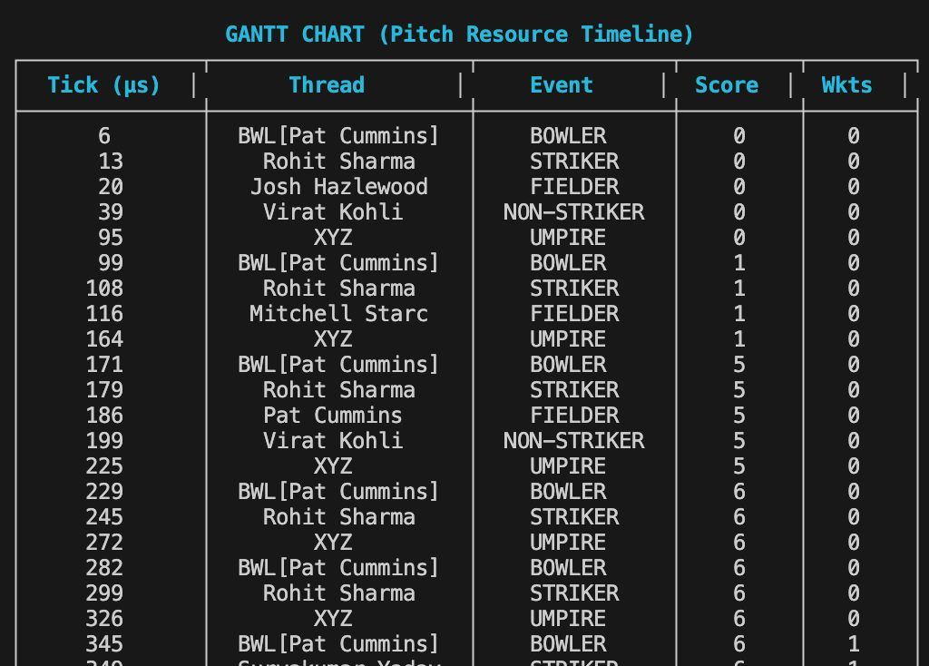
GANTT CHART
The Gantt chart is a real-time thread activity log. Each row represents one thread becoming active, recording:
Timestamp in microseconds from innings start
Thread name and event type
Score and wickets at that moment
gantt_log() is called by every thread the moment it acquires state_mx and begins work, giving a precise picture of thread execution order across the entire match.

Slide 15
CONCLUSION
Concurrency Models Reality: Multithreading proved to be the perfect paradigm for a sports simulator. Having independent threads for Batsmen, Bowlers, and Fielders continuously running in parallel accurately mirrors the real-time, simultaneous dynamics of a live cricket match.
Deadlocks as a Feature: In traditional OS design, deadlocks are fatal errors. In this simulator, they are a game mechanic. By repurposing the Resource Allocation Graph (RAG) and cycle-detection algorithms, we creatively mapped thread deadlocks to "Run-Outs" (two players fighting for the same crease resource), turning a system failure into a realistic match outcome.

Slide 16
CONCLUSION
Order Out of Chaos: Despite 14+ independent threads constantly preempting each other and competing for shared memory, the system maintains absolute data integrity. Strict synchronization ensures the scorecard, run counts, and Gantt logs remain 100% accurate without a single race condition.
Final Takeaway: This project demonstrates that low-level operating system mechanisms (mutexes, condition variables, and schedulers) aren't just for managing CPUs—they are powerful tools for architecting complex, highly synchronized, and scalable simulations of the real world.

Slide 17
THANK YOU
Presented by Group-12

